Slide 1
How to change my bad memory?
Close your eyes and look to the image of a memory which gives you pain or which is blocking you to feel well.
Change bright colors into grey.
If it is moving stop the moving.
Make the image with your hands smaller
Push it at more distance from you.
Blow it in the sky, let it disappear behind the horizon.
PFFFFFFFFFFFFFFFFFFFFFFFFFFFFFFFFFFFFFFFFFFFFFFFFFFF

Slide 2
Changing submodalities 1
Do you want to change bad memories?
Than change the submodalities! Make it paler, greyer, reduce size and push it far away.
This will reduce the intensity of the pain of the memory.

Slide 3
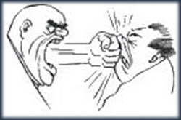
Swish paterns
To work with changing submodalities of your internal representation
smaller
less contrast
S W I S H

Slide 4
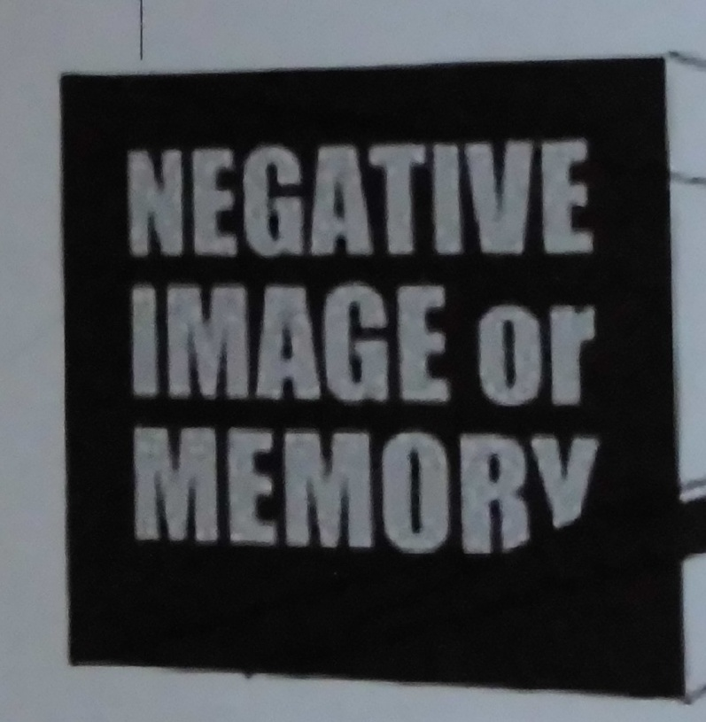
Make your image of your negative emotions smaller, with less contrast, and push it away.

Slide 5
Change Submodalities 1
Blow it into the sky and let it disappear
Negative memory:
Visual Submodalities:
Big
Bright Color
High contrast
Close
Visual Submodalities
Smaller
Lower contrast
Grey, no colors
Far away

Slide 6
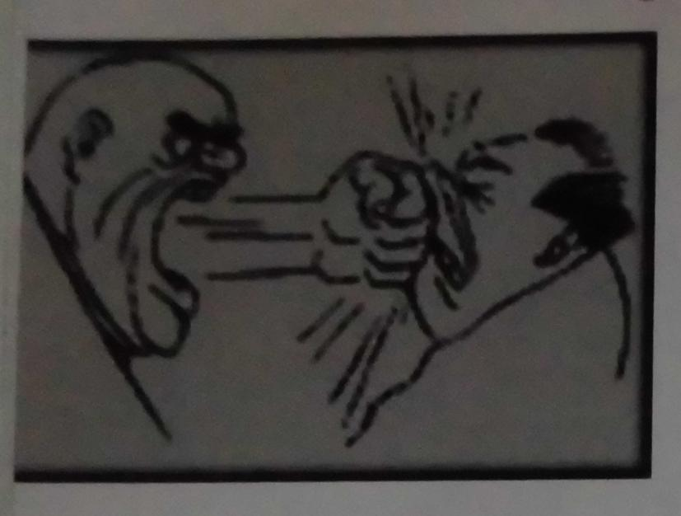
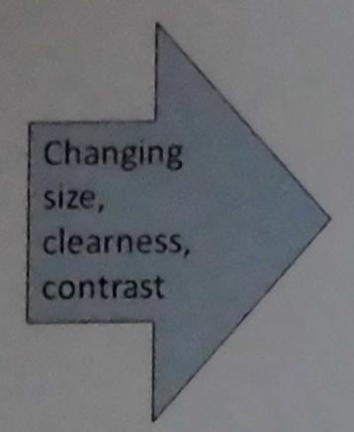
Changing submodalities

Slide 7
Blow away a negative memory

Slide 8
Changing submodalities 2
Do you want to cheer up good memories?
Than change the submodalities! Make it brighter, more colorful, bigger and pull it to your heart.
This will increase the intensity of the joy of the memory.

Slide 9
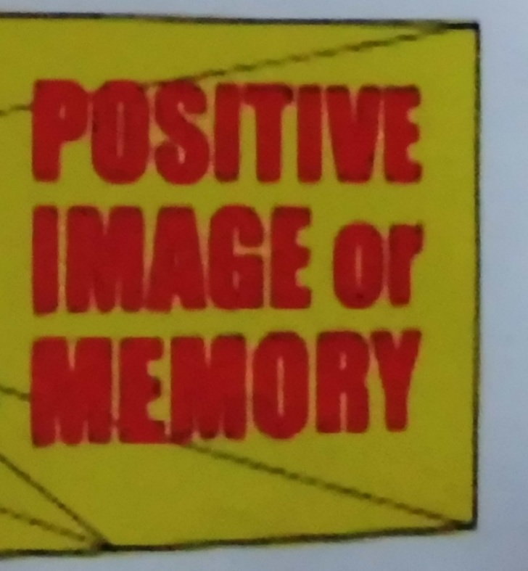
Make your image of your positive emotions bigger, with more contrast, and pull it to your heart.

Slide 10
Making a positive memory still stronger
more contrast
bigger
S W I S H

Slide 11
How to make a good memory more intense?

Slide 12
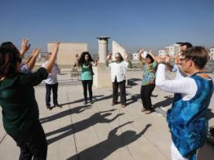
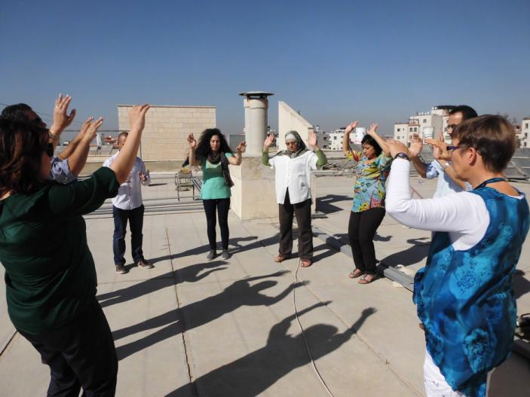
Visual Submodalities
Visual Submodalities
Colors->Black and white
Visual Submodalities
High Contrast → Low
Visual Submodalities
Size: big → small
Location: high → low
Visual Submodalities

Slide 13
What are visual submodalities?
Vision, Hearing, Feeling are ‘modalities’.
Every ‘modality’ has ‘submodalities’ which help us in experiencing our internal representation.
Visual submodalities:
brightness, dark or bright
size, big or small
color or black and white
contrast high or low
movie or a still picture

Slide 14
Submodalities
IV = Visual, looking, seeing
Associated / Disassociated
Framed or Unbounded
Black & White or Color
Bright or Dim
Size of Picture
Near or Far
Location
Moving or Still
If a Movie-Fast/Normal/Slow
Focused or Defocused
From beneath of above, from the left or from the right side seen
3-Dimensional or Flat
A = Auditive, hearing, listening
Loud or Soft
Rhythm
Emphasis on specific words
Fast or Slow
Pauses
High or Low Pitch
Timbre
Location
Direction
Duration
Internal or External
Verbal or Tonal
Stereo or Mono
Near or Far
Clarity
feeling? K = Kinesthetisch
Temperature: Hot or Cold
Texture: Smooth or Rough
Vibration
Pressure
Movement
Duration
Intensity, Strong or Weak
Size
Shape
Weight: Heavy or Light
Internal or external
Constant or Intermittent
Location
Large Area or Small Area

Slide 16
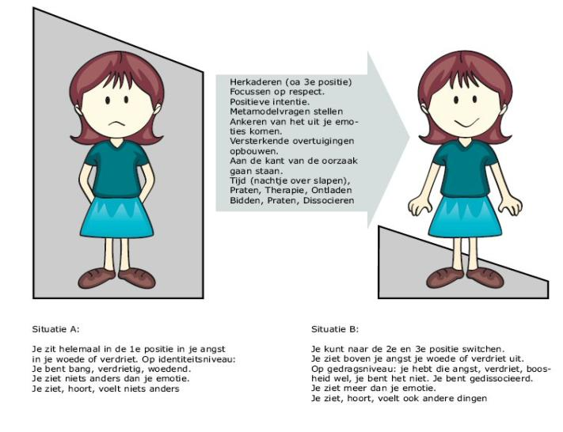
Coming out of the box
إعادة تأطير (استخدم الضمير الغائب)
ركز على الاحترام
النوايا الايجابية
اسأل أسئلة نموذج التدقيق
محور ما يخرج من مشاعرك
قم ببناء معتقدات مدعمة
ناصر القضية
وقت (نام على ذلك)
تحدث، جلسة معالجة، فرغ الشحنات، صلي، إفصل

